Slide 1
SPECY-NETWORK
Automation Made Easy
a COSMOS Layer-1 for verifiable low-code automation on multichains

Slide 2
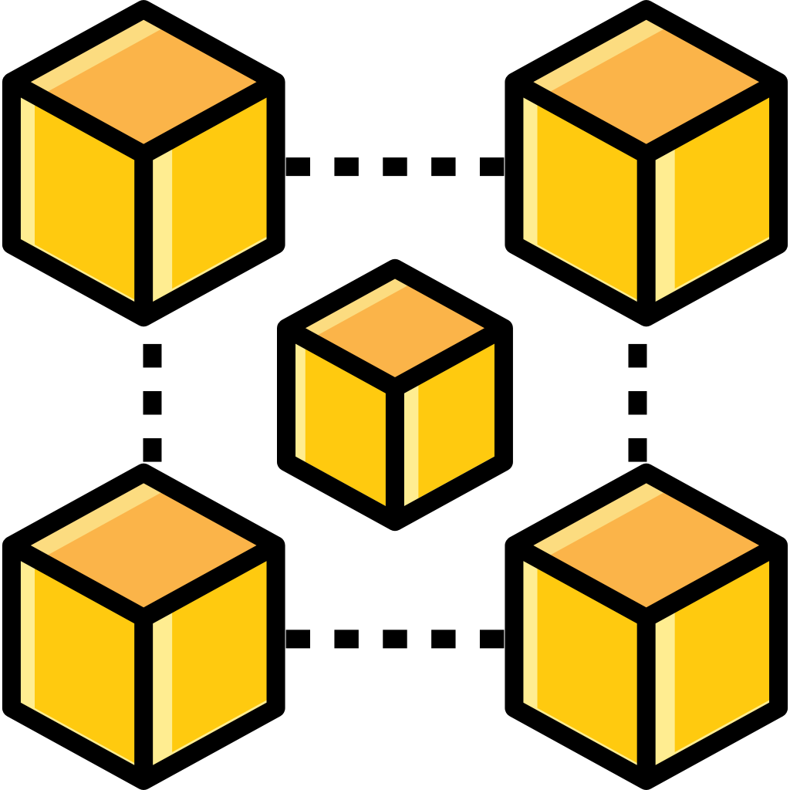


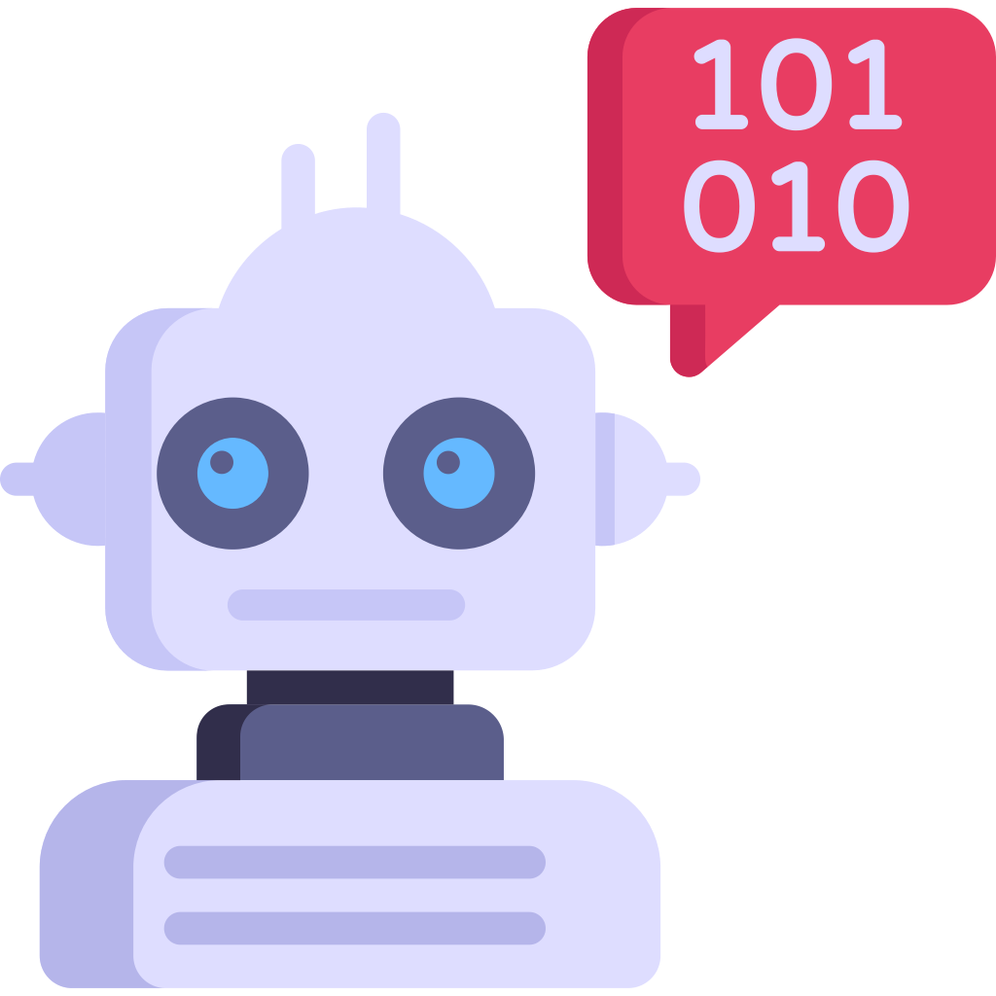




on chain
Blockchain
Application
contract
Automation
contract
off chain
Condition contract
Executor
Chainlink Automation
Notes:
一句话简单介绍一下specy network，我们是一个专注于web3合约自动化的layer1网络。
简单介绍一下什么是合约自动化
合约自动化并不是一个全新的想法，chainlink Automation，Gelato network，autonomy等项目也都在以太坊，polygon等evm生态链上提供了自动化服务。

Slide 3
on chain
Hard to define a task
function check()
{
uint256[] memory _openedLoans = loanNFT.getAllOpenedLoans();
uint256[] memory _upkeepLoans = new uint256[](maxLiquidationsPerUpkeep);
uint32 _numUpkeeps = 0;
for (uint256 _i = 0; _i < _openedLoans.length; _i++) {
if (_numUpkeeps >= maxLiquidationsPerUpkeep) {
break;
}
uint256 _tokenId = _openedLoans[_i];
if (_shouldLiquidateLoan(_tokenId)) {
upkeepNeeded = true;
_upkeepLoans[_numUpkeeps] = _tokenId;
_numUpkeeps++;
}
}
if (upkeepNeeded) {
performData = abi.encode(_upkeepLoans);
}
}
function _shouldLiquidateLoan(uint256 _tokenId) internal view returns (bool) {
if (!loanNFT.doesTokenExist(_tokenId)) {
return false;
}
(, uint256 _ltvWithFeesX96, , ) = getLTVX96(_tokenId);
return _ltvWithFeesX96 >= (FixedPoint96.Q96 * liquidationLTV) / DENOMENATOR;
}
function getLTVX96()
{
require(loanNFT.doesTokenExist(_tokenId), 'GETLTV: loan must exist');
Loan memory _loan = loans[_tokenId];
uint256 _fees = calculateAPRFees(_loan.amountETHBorrowed, _loan.aprStart);
if (_loan.amountDeposited == 0 && _loan.amountETHBorrowed == 0) {
return (0, 0, 0, 0);
}
uint160 _sqrtPriceX96 = _twapUtils.getSqrtPriceX96FromPoolAndInterval(
_loan.collateralPool
);
uint256 _priceX96 = _twapUtils.getPriceX96FromSqrtPriceX96(_sqrtPriceX96);
address _token0 = IUniswapV3Pool(_loan.collateralPool).token0();
uint256 _amountETHDepositedX96 = _token0 == _WETH
? _loan.amountDeposited * (2 ** (96 * 2) / _priceX96)
: _priceX96 * _loan.amountDeposited;
uint256 _amountETHBorrowedX96 = _loan.amountETHBorrowed * FixedPoint96.Q96;
uint256 _amountETHBorrWithFeesX96 = (_loan.amountETHBorrowed + _fees) *
FixedPoint96.Q96;
return (
(_amountETHBorrowedX96 * FixedPoint96.Q96) / _amountETHDepositedX96,
(_amountETHBorrWithFeesX96 * FixedPoint96.Q96) / _amountETHDepositedX96,
_amountETHDepositedX96,
_amountETHBorrowedX96
);
}
Blockchain
Application
contract
Automation
contract
off chain
Condition contract
Executor
Chainlink Automation
Notes:
一句话简单介绍一下specy network，我们是一个专注于web3合约自动化的layer1网络。
简单介绍一下什么是合约自动化
合约自动化并不是一个全新的想法，chainlink Automation，Gelato network，autonomy等项目也都在以太坊，polygon等evm生态链上提供了自动化服务。

Slide 4
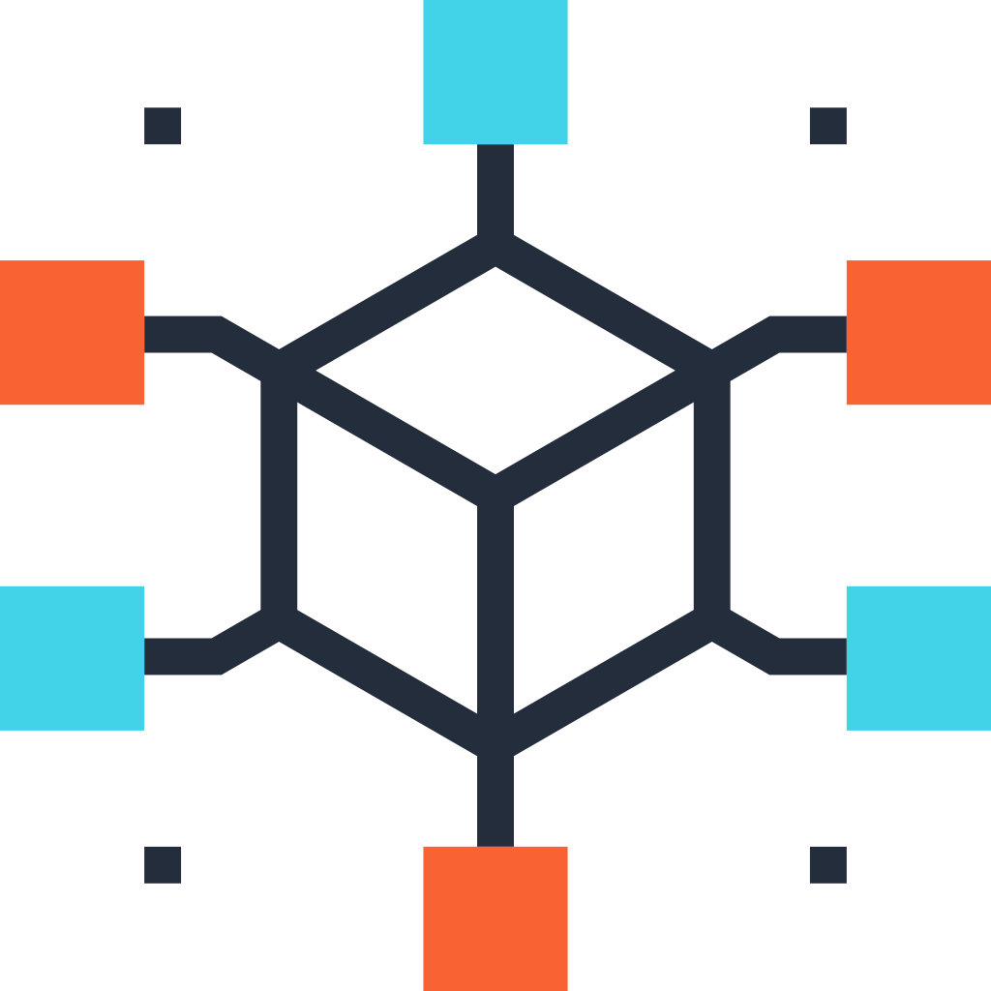

on chain
Hard to define a task
Black-box to trigger
Blockchain
Application
contract
Automation
contract
off chain
Condition contract
Executor
Network
Stake
existing solutions are insufficient
Chainlink Automation
Notes:
一句话简单介绍一下specy network，我们是一个专注于web3合约自动化的layer1网络。
简单介绍一下什么是合约自动化
合约自动化并不是一个全新的想法，chainlink Automation，Gelato network，autonomy等项目也都在以太坊，polygon等evm生态链上提供了自动化服务。

Slide 5



on chain
Automation Programming Language
Blockchain
Application
contract
Automation
contract
T
T
rule 4
rule 2
T
off chain
F
T
outputdata
inputdata
rule 1
Condition contract
Executor
F
rule 5
F
rule 3
condition mismatch
rule 6
Notes:
一句话简单介绍一下specy network，我们是一个专注于web3合约自动化的layer1网络。
简单介绍一下什么是合约自动化
合约自动化并不是一个全新的想法，chainlink Automation，Gelato network，autonomy等项目也都在以太坊，polygon等evm生态链上提供了自动化服务。

Slide 6
on chain
Automation Programming Language
regulation erc20
entities {
entity openLoans {
tokenID is number
ltvWithFeesX96 is number
}
entity liquidation {
DENOMENATOR is number
liquidationLTV is number
Q96 is number
}
}
output {
upkeepLoans is list
}
rules {
rule liquidate {
ltvNeedLiquidate = (liquidation.Q96 * liquidation.liquidationLTV) / liquidation.DENOMENATOR
outputdatas.upkeepLoans = collect openLoans.tokenID
where openLoans.ltvWithFeesX96 >= ltvNeedLiquidate
}
}
execution {
check rule liquidate
}
Blockchain
Application
contract
Automation
contract
off chain
Condition contract
Executor
Notes:
一句话简单介绍一下specy network，我们是一个专注于web3合约自动化的layer1网络。
简单介绍一下什么是合约自动化
合约自动化并不是一个全新的想法，chainlink Automation，Gelato network，autonomy等项目也都在以太坊，polygon等evm生态链上提供了自动化服务。

Slide 7
on chain
Automation Programming Language
Verifiable Task Execution
Blockchain
Application
contract
Automation
contract
T
T
rule 4
off chain
rule 2
T
F
T
outputdata
Condition contract
Executor
inputdata
rule 1
F
rule 5
F
rule 3
condition mismatch
rule 6
TEE PROOF:
{
rulefilehash: “”
inputdata: {}
rules: {“rule 1”, “rule 3”, “rule 5”}
outputdata: {}
}
ZKPROOF（OnDeveloping）:
{
zkproof :“”
signature :“”
}
Notes:
一句话简单介绍一下specy network，我们是一个专注于web3合约自动化的layer1网络。
简单介绍一下什么是合约自动化
合约自动化并不是一个全新的想法，chainlink Automation，Gelato network，autonomy等项目也都在以太坊，polygon等evm生态链上提供了自动化服务。

Slide 8
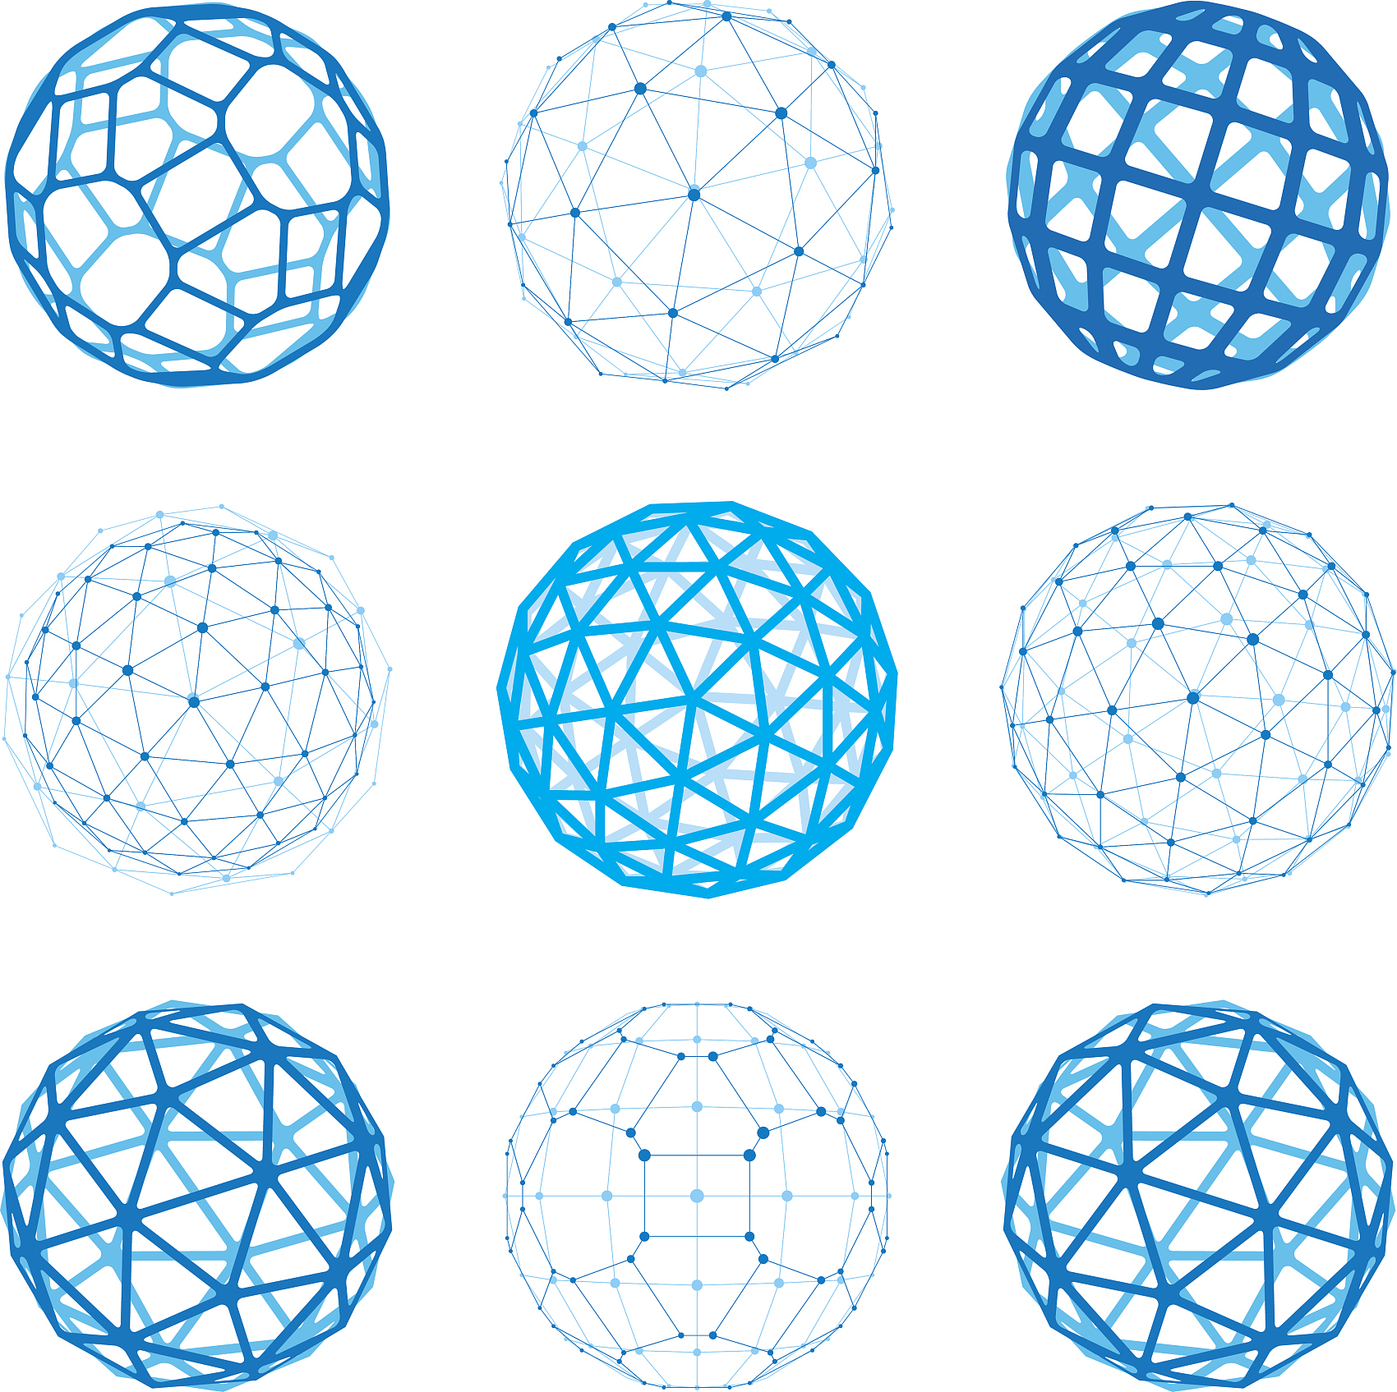





on chain
Automation Programming Language
Verifiable Task Execution
Blockchain
Application
contract
Automation
contract
Multi-chain Support
off chain
IBC
Condition contract
Executor
Specy-Chain
Cosmos Hub
EvmOS
Osmosis
Executor
Data Source
Notes:
一句话简单介绍一下specy network，我们是一个专注于web3合约自动化的layer1网络。
简单介绍一下什么是合约自动化
合约自动化并不是一个全新的想法，chainlink Automation，Gelato network，autonomy等项目也都在以太坊，polygon等evm生态链上提供了自动化服务。

Slide 9
on chain
Automation Programming Language
Verifiable Task Execution
Blockchain
Application
contract
Automation
contract
Multi-chain Support
off chain
Open Framework
Condition contract
Executor
Notes:
一句话简单介绍一下specy network，我们是一个专注于web3合约自动化的layer1网络。
简单介绍一下什么是合约自动化
合约自动化并不是一个全新的想法，chainlink Automation，Gelato network，autonomy等项目也都在以太坊，polygon等evm生态链上提供了自动化服务。

Slide 10



Osmosis
EvmOS
Cosmos Hub
Task Manager
Executor
Manager
Keepers
ICA
IBC Core
User
Task
Specy Module
IBC Module
Automation language file
Event
Listener
Engine
Service
Data
Service
Subgraph
Scheduler
...
Automation Language Interpreter
The Graph
Scheduler
Engine（TEE/ZK）
Executor
Data Source
Notes:
specy network设计中涉及到的角色可以分为三个。
第一个是目标链，也就是用户真正期望交易发生的位置。当前的目标链可以是任意一个支持了IBC协议的区块链，如osmosis，evmos等
第二个是specy chain，负责用户，任务和Executor的管理。同时负责通过IBC将交易路由到target chain上
第三个是Executor，Executor是链下的任务执行引擎。由三个部分组成，Scheduler负责注册任务的调度，Engine是运行在可信环境内的执行引擎，负责任务的执行，Database则负责为Engine的执行提供链上链下的数据。

Slide 11
autofollow specy task：
Notes:
接下来用视频来看一下这个demo完整的流程。

Slide 12
Thank You
SPECY-NETWORK
Make multi-chain automation tasks possible

